Slide 1
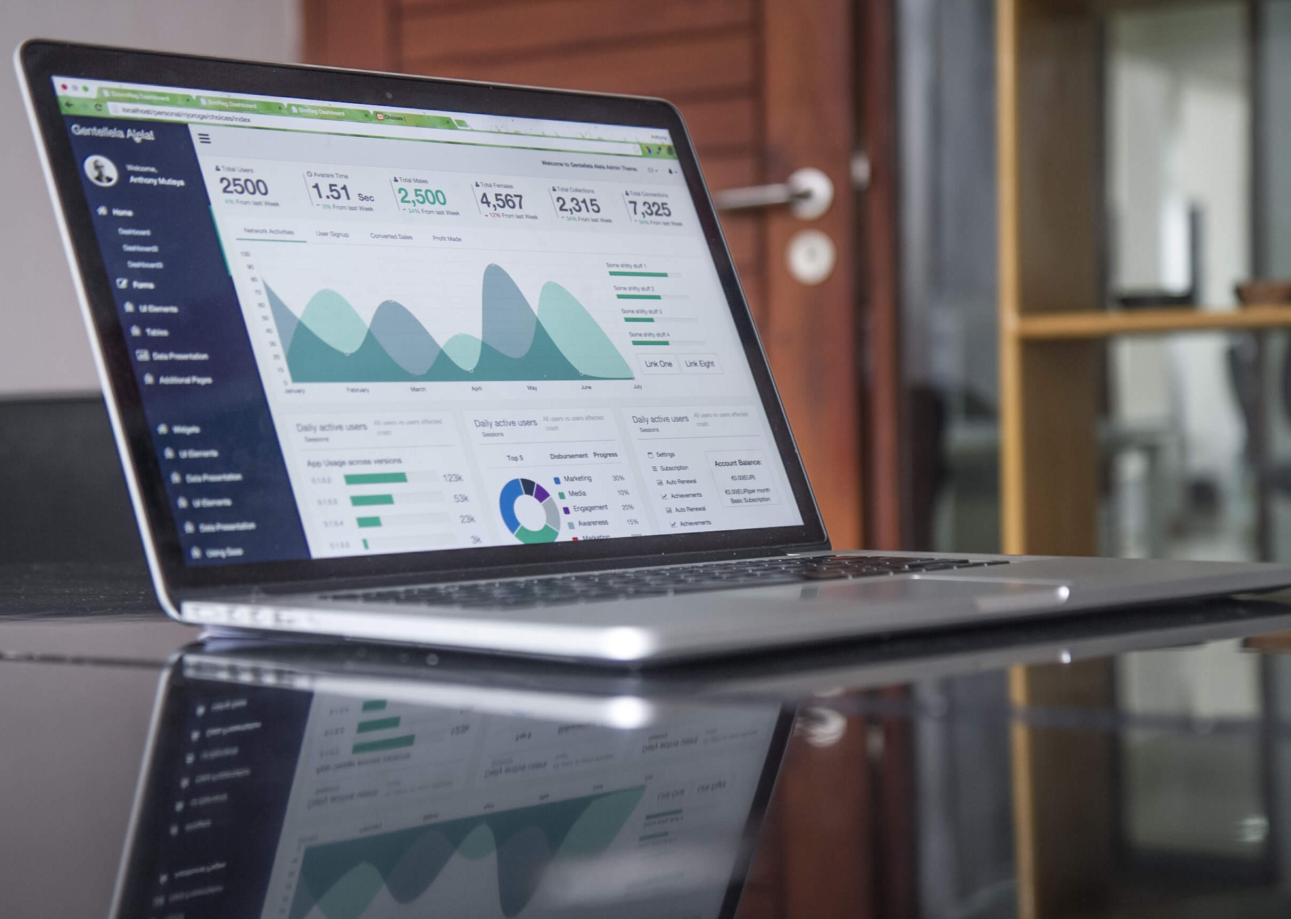
Creating Dashboards
Building blocks of creating a Dashboard on any Tool
by Kunaal Naik

Slide 2
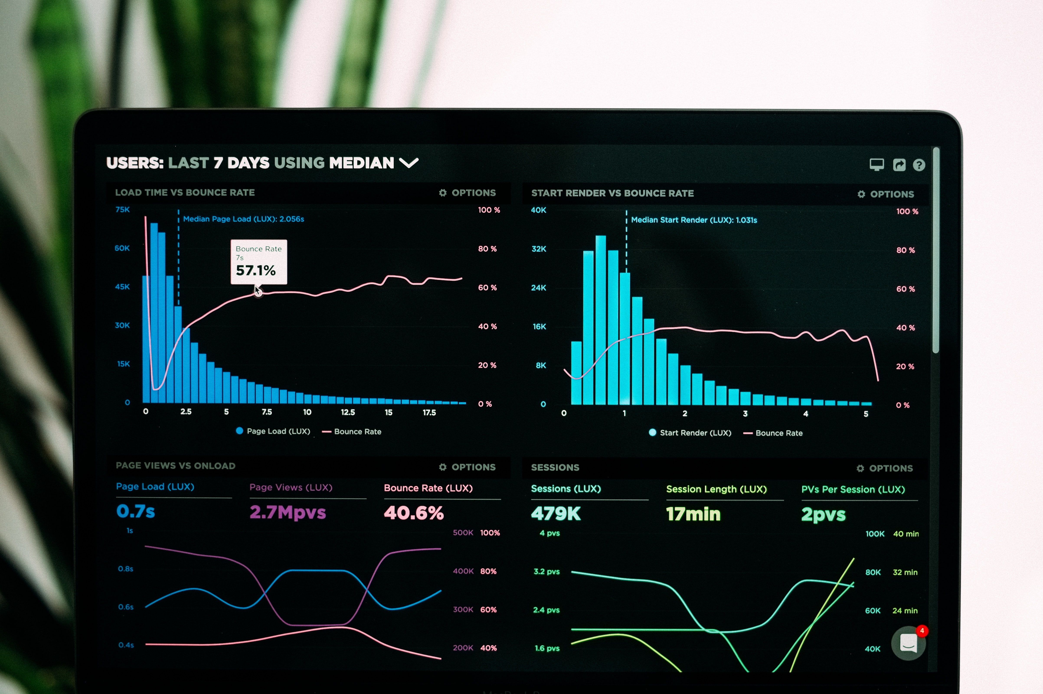
About Dashboards
A Dashboard is a tool used for information management and driving business actions. Much like the Cricket Scoreboard or even Dashboard of a Car.
Building Blocks of Dashboard
Raw Data – Joins, Summarizing, etc..
Business Context – Creating relationships for user
Reporting Layer of Data - or Cleaned Data
Data Chunks – To be used to create charts or inform
Adding User control – Form Controls such as Drop down’s
Linking Form controls – Make charts dynamic
Placing Charts – As per Business context
Finally Automating for refreshing the data

Slide 3
Business Context
Dashboard to Measure Monthly performance
Show Sales performance based on Monthly Y/Y Comparison and Previous Month Comparison
Also, show Year to Date comparison
Compare Sales between States of each region in the same time Range – Mapping provided
Compare Products(Furnishings & Public Areas) and other Product Categories
Allow user to see information by overall and by Region specific view of the same numbers
Allow user to go back on forth on the Month he wants to review. Also, ensure when new data comes in the same summary is automatically refreshed for the new month

Slide 4
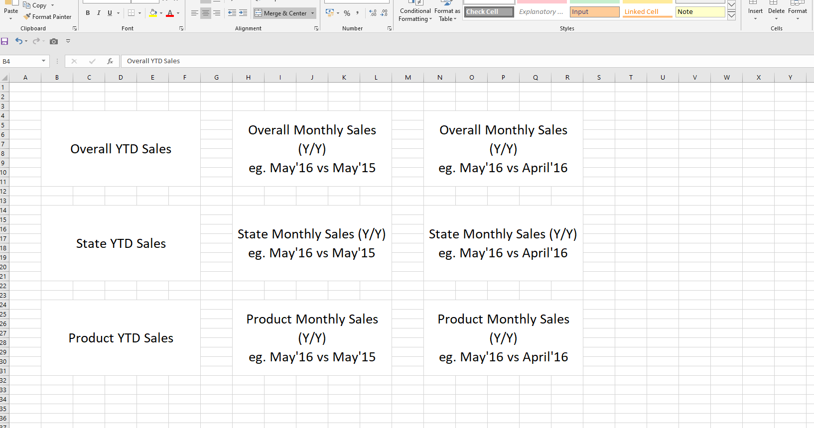
Final Objective

Slide 5
Thank You

